Slide 1
Business Level Strategy and the Industry Environment Week 7, Chapter 6, 2020
MGT703 Strategic Management
Notes:
USC introductory lecture slide.

Slide 2
Notes:
This copyright notice should remain at the beginning of every lecture.

Slide 3

Three key concepts from last week
Concept 1: Broad and focus cost leadership
Concept 2: Broad and focus differentiation
Concept 3: Blue Ocean Strategy & Value Innovation
Notes:
Highlight key learning from the last class.
Use the activity icons (found on the last slide in this template) to indicate what students should be doing or flag content relevant to assessment items

Slide 4

Learning objectives
Identify strategies in fragmented industries.
Explain how fragmented industries can become more consolidated
Discuss strategies for companies competing in the different stages of the industry life cycle
Notes:
If it’s the first lecture of the semester or session, the learning outcomes for the course would be shown on this slide.
In subsequent lectures, you could show any course learning outcomes that pertain to the week’s lecture.

Slide 5

Fragmented industries (LO1)
Composition is a large number of small and medium-sized companies.
Reasons for fragmentation
Lack of scale economies
Brand loyalty in the industry is primarily local
Low entry barriers due to lack of scale economies and national brand loyalty
Focus strategy (cost leader or differentiation) usually works best for a fragmented industry.

Slide 6
Consolidating a fragmented industry (LO2)
Value innovation: Defines value differently than established companies.
Offers the value at lowered cost through the creation of scale economies.
Offers the value at increased quality as a result of the cost savings
Chaining: Obtaining the advantages of cost leadership by establishing a network of linked merchandising outlets.
Interconnected by information technology that functions as one large company.
Aids in building a national brand.
Standardised operating procedures
Shared marketing arrangements

Slide 7
Consolidating a fragmented industry (cont’d)
Franchising: Strategy in which franchisor grants the franchisee the right to use the franchisor’s name, reputation, and business model in return for a fee and a percentage of the profits.
Advantages
Finances the growth of the system, resulting in rapid expansion.
Franchisees have a strong incentive to ensure that the operations are run efficiently.
New offerings developed by a franchisee can be used to improve the performance of the entire system.
Transfers some risk to the business owner (franchisee)

Slide 8
Consolidating a fragmented industry (cont’d)
Disadvantages
Tight control of operations is not possible.
Major portion of the profit go to the franchisee.
When franchisees face a higher cost of capital, it raises system costs and lowers profitability.
Horizontal mergers: Merging with or acquiring competitors and combining them into a single large enterprise.

Slide 9
Strategies in embryonic industries (LO3)
Initial product and service offering to market segment described as ‘innovators’
Next phase of product and service offering to market segment described as ‘early adopters’
Industry enters the growth stage when a mass market starts to develop for its products, that is, when large numbers of customers enter the market.
This occurs when:
Product value increases, due to ongoing technological progress and development of complementary products.
Production cost decreases, resulting in low prices and high demand.

Slide 10
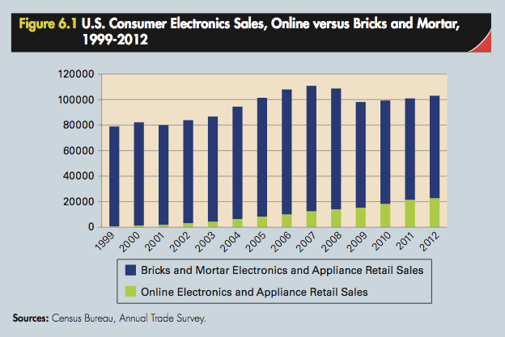
Retail store sales versus online store sales

Slide 11
Ballantynes, Christchurch, New Zealand
Established in 1854
Retail on store sales for 140 years
Tragedy in 1947 when store burns to the ground
Major reforms implemented to national fire service and building code
Online sales in recognition of industry life cycle
Tragedy strikes again in 2011 when earthquake destroys the building
Online sales enabled trade to continue

Slide 12
Market segments – embryonic and growth stages
Innovators
First to purchase and experiment with a product based on new technology.
Early adopters
Understand that the technology may have important future applications.
Early majority
Practical and understand the value of new technology.
Late majority
Purchase a new technology only when it is obvious that it has great utility and is here to stay.
Laggards
Unappreciative of the uses of new technology.

Slide 13
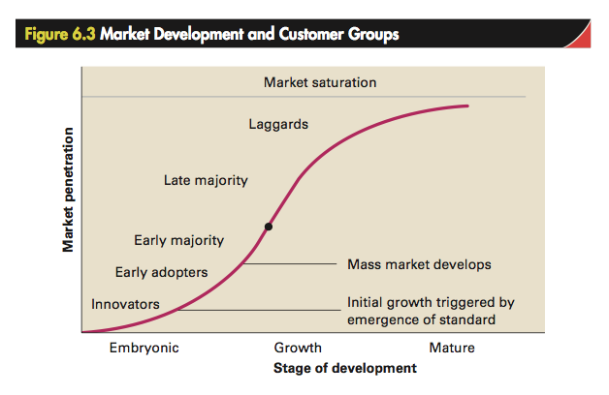
Market segments (cont’d)

Slide 14
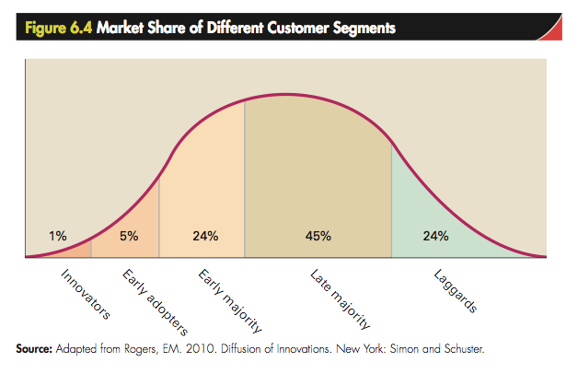
Market segments (cont’d)

Slide 15
Awareness of changing segments is vital
New strategies are required to strengthen a company’s business model as a market develops.
Customers in each segment have very different needs.
Monetising models need to change with each new segment
Competitive chasm: Transition between the embryonic stage and the growth stage (mass market).
Failure to do so results in the company going out of business or being forced to sell in the ‘shake-out’ stage.

Slide 16
Crossing the chasm
Innovators and early adopters
Early majority
Technologically sophisticated and willing to tolerate the limitations of the product.
Reached through specialised distribution channels.
Companies produce small quantities of product that are priced high.
Appreciate value associated with ease of use and reliability.
Require mass-market distribution and mass-media advertising campaigns.
Require large-scale mass production to produce high quality products and services that are price competitive.

Slide 17
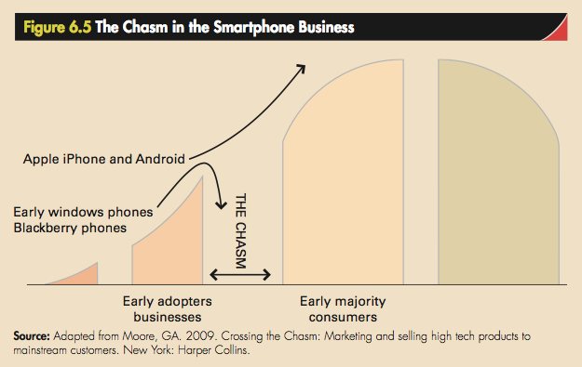
Smartphones example

Slide 18
Factors that accelerate customer demand
Relative advantage
Degree to which a new product is perceived as better at satisfying customer needs than the product is supersedes
Complexity
Products perceived as complex and difficult to use will diffuse more slowly than those with superior functionality
Compatibility
Degree to which a new product is perceived as being consistent with the current needs or existing values of potential customers

Slide 19
Factors that accelerate customer demand (cont’d)
Trialability
Degree to which potential customers can experiment with a new product during a ‘hands-on’ trial
Observability
Degree to which the results of using and enjoying a new product can be seen and appreciated by other people
Going viral
Lead adopters influence others to purchase

Slide 20
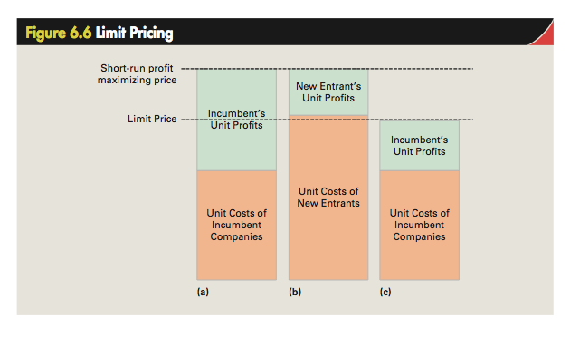
Maturity stage

Slide 21
Strategies to manage rivalry in mature stage
Price signaling
Product and/or service increase and/or decrease
Non-price competition
Product and/or market expansion to deter new entrants

Slide 22
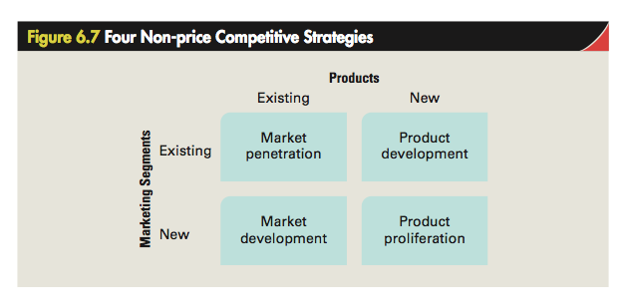

Slide 23

Factors causing industry to decline
Slowing demand for products and services
High exit barriers
High fixed costs
Product commoditisation

Slide 24
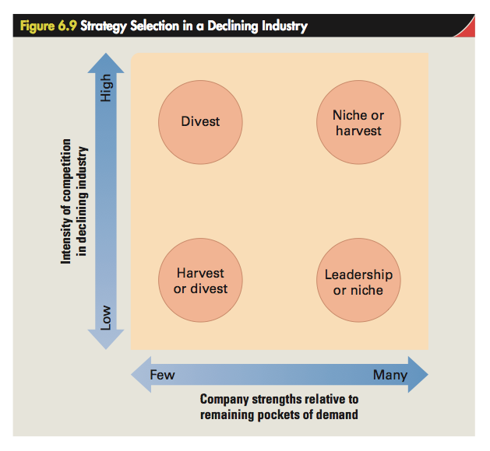

Slide 25
Declining industries
Leadership strategy: When a company develops strategies to become the dominant player in a declining industry.
Niche strategy: When a company focuses on pockets of demand that are declining more slowly than the industry as a whole to maintain profitability.
Harvest strategy: When a company reduces to a minimum the assets it employs in a business to reduce its cost structure and extract maximum profits from its investment.
Divestment strategy: When a company decides to exit an industry by selling off its business assets to another company.

Slide 26
Outlook
Week 7 Post-class activities
Review guideline responses to discussion questions
Attempt Chapter 6 quiz in the online interactive textbook
Week 8: “Strategy and Technology” Pre-class activities
Read Chapter 7 of the online interactive textbook
Watch the summary video for Week 8
Prepare responses to the Week 8 discussion questions
Read the article provided on Blackboard

